Slide 1
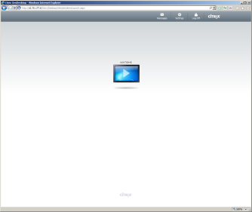
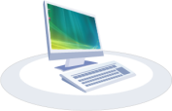
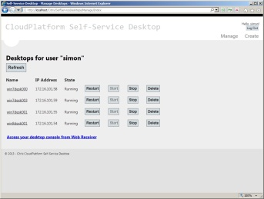
Use
Desktop
XenDesktop Broker
XenDesktop
Desktop Access
Windows Desktops
Self Service Desktops
Agent (sync)
Self Service
Create & Manage
Desktop
CloudPlatform
Self Service Desktops
Web App
Desktop Management

